Slide 1
Thoughts on
Comp Arch Futures
Robert Colwell
R&E Colwell & Assoc. Inc.
Oh.
Why does this guy
look so worried?

Slide 2
My Perspective on Computer Architecture Research
Is not about instruction sets or ISAs
Has sometimes been about systems & interconnects
Biggest payoff has been microarchitectures for 35+ years
Winning formula
Think of a new tweak, simulate in isolation for perf impact
If big enough, include in design or write paper
Accumulate ideas into new product
Apply “windage”
Experienced designers judge sims down: implementation issues or “feature crosstalk”
If publishing, leave out, hope referees don’t notice (they probably won’t)
Don’t go too far or cost, complexity or schedule slips will sink you
Repeat until out of time, then tape out

Slide 3
Classic Microarchitecture Paradigm No Longer Works
It has several serious flaws going forward.
It presumes that perf improvements are all that matter for winning product
This has not been true for at least 10 years
It does not account for opportunity costs
New ideas cost
Design time
Chip real estate
Degradation of other features
But mainly it ignores power dissipation, and you can no longer (ever) do that

Slide 4
uArch Perf Tweaks Mean Nothing In Isolation Any More
My new Total Speculation Cache makes my design 12.4% faster.
You are an idiot.

Slide 5
Don’t Get Trapped in the Horizontal Mindset
Computer systems are extremely complex.
You are taught to think of them in horizontal layers
Apps at top
OS under that
Instruction set arch
Microarchitecture
Circuits
Gates/devices (and so on)
But electronic systems don’t care how you think of them. They must work correctly at all levels, all the time. And they will only do that if you design them so they can’t possibly do anything else.
You must be able to transcend the horizontal mindset.

Slide 6
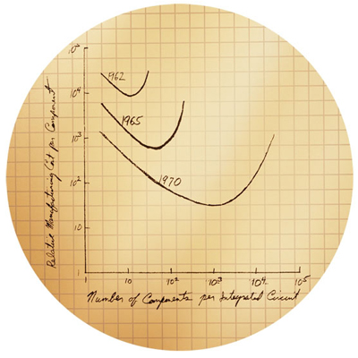
Future Good Ideas in Comp Arch Must Comprehend…
Power
Energy & cooling
Signalling
Errors from worsening CMOS
Huge, bloated SW and/or buggy apps
Battery form factors, weight, lifetime, recharging
Packaging
EMI, RFI, radiation
Unbalanced systems from unbalanced components
very slow DRAM, low bandwidth I/O
High cost pressure from impending commoditization
And the end of Moore’s Law

Slide 7
Where to look, what to consider
Ask the right questions
What do buyers really want?
They don’t want to buy computers, they buy solutions
Faster isn’t always better
Where should computations be done?
Locally?
Cloud?
How should computations be done?
No more {bits; ops; movement} than necessary
No faster than necessary
Would approximate solutions work?
Find right balance in heterogeneous system (and learn to program it!)
What will your new product do that’s never been possible before?
Most Importantly
It isn’t technology that rules the computer kingdom.
It’s economic$.

Slide 8
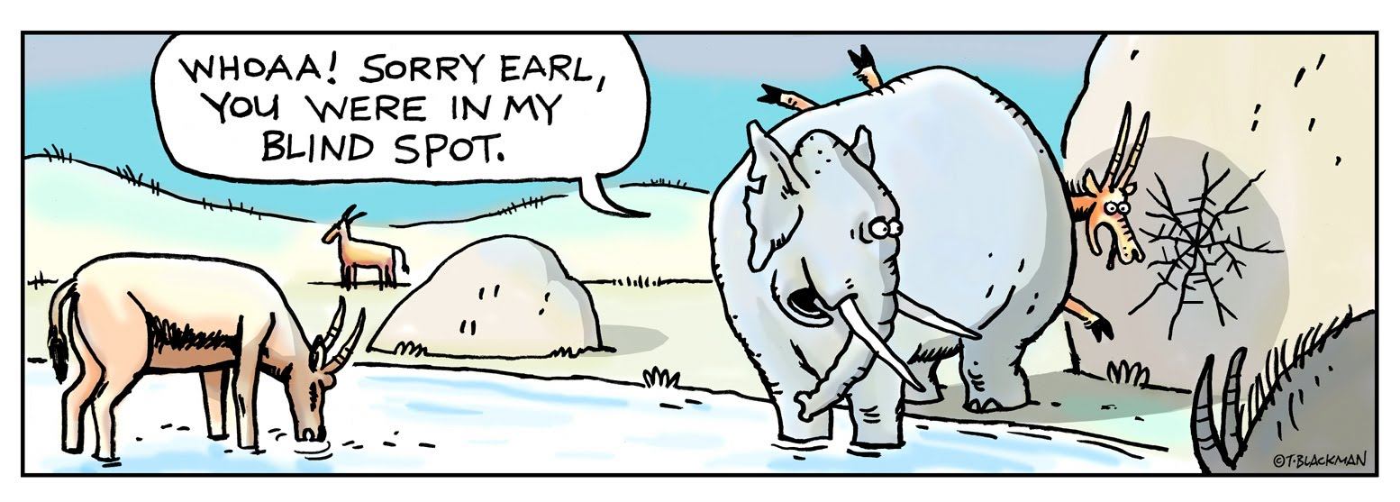
Last Words, far beyond computer architecture
Don’t believe everything you hear today from us “old guys”
If instruction set design is your passion, I think you’re nuts, but go prove me wrong and I’ll salute you
We all have our blind spots
Your job is to avoid ours so you can have your own
Note that this talk assumed no new technology would come online
That was on purpose to show what a blind spot looks like
That’s my story and I’m sticking to it
The more certain we old guys are, the more skeptical you should be
I’m sure of that

Slide 9
The End

